Slide 1

Capstone Project: Trends and Cost Analysis of Flap Surgeries
DATA 205
By: Katherine Ochoa

Slide 2
General Information

Slide 3

Flap Surgery
Free tissue transfer.
Reconstructive surgery
Transfer of skin or tissue from one area of the body to another.
Composed of any combination of skin, fascia, muscle and bone.
Benefits:
Stable wound coverage
Improved aesthetic and functional outcomes
Minimal donor site morbidities
Blood supply remains intact

Slide 4
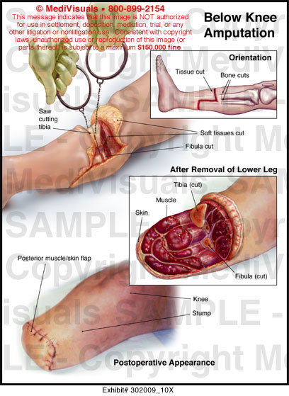
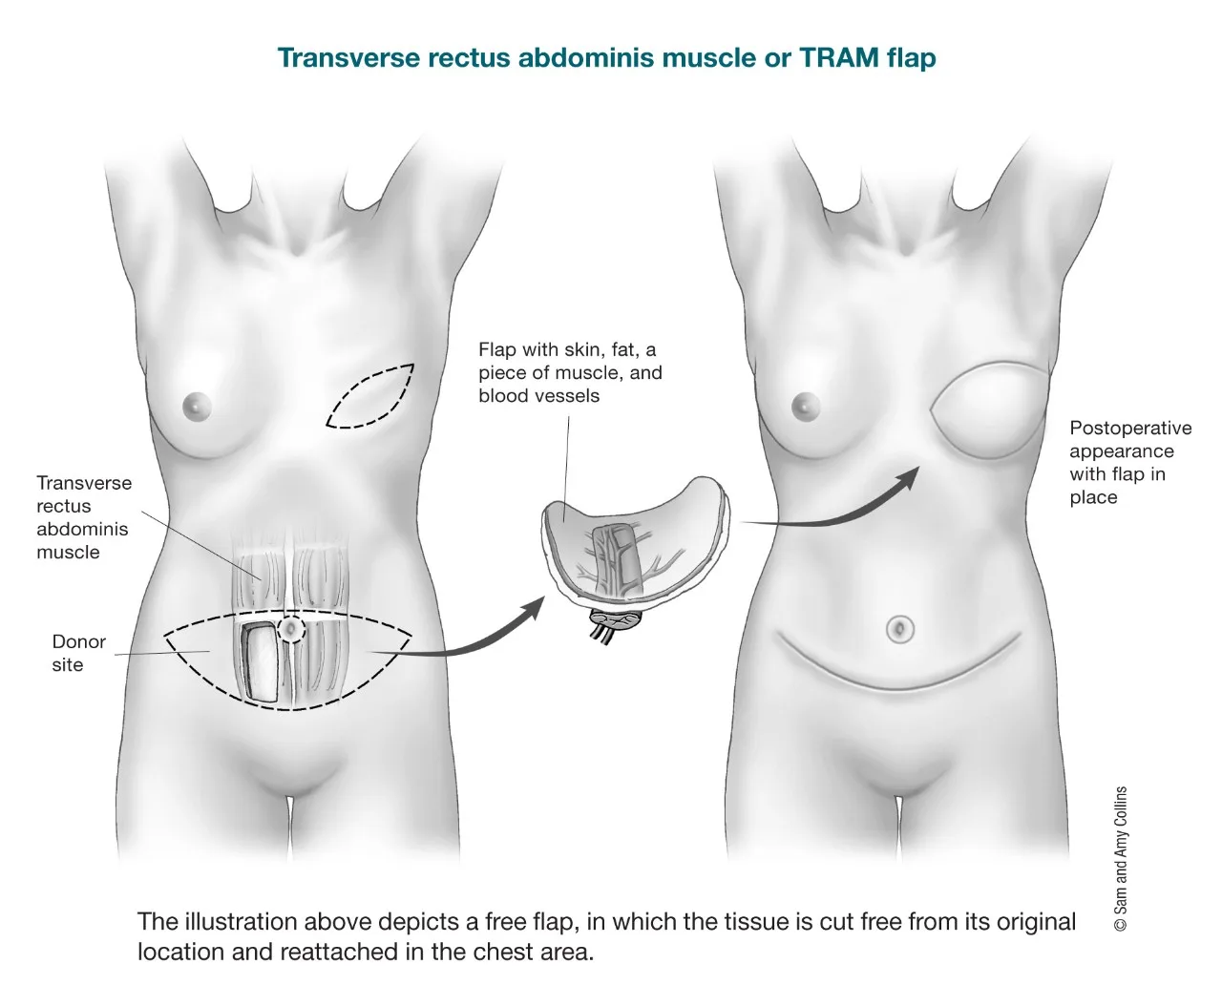
Flap Procedure Examples
Trauma
Removal of cancerous mass
Source: American Cancer Society
Source: MediVisuals

Slide 5
ICD Codes
International Classification of Diseases
Common language for recording, reporting and monitoring diseases
Compare and share data in a consistent and standard way throughout the world
Used to report diagnoses and procedures for billing purposes

Slide 6
Project Plan

Slide 7
Dataset Source
Healthcare Cost and Utilization Project (HCUP)
National Inpatient Sample (NIS)
Data on over 7 million hospital stays.
Data from all states participating in HCUP.
ICD-10:
2016 - 2019
Core
Nation’s most comprehensive source of hospital care data.
Covers over 97% of the U.S. population.
Core: Contains commonly used data (age, primary payer, total charges, etc.)
Data recorded from 1988 – 2020.
Switch from ICD-9 to ICD-10 billing codes in 2015
Pandemic in 2020

Slide 8
Tools Utilized
R Studio
Excel

Slide 9
Project Goals
Discover national trends
Patient Care
Common procedures
Cost analysis
Annual rate of average charge
Cost of procedures
Patient survival
Trends in age, race, sex

Slide 10
Data Ingestion and Wrangling

Slide 11

Data Ingestion
Read in the 4 csv files (Core 2016 – Core 2019)
Define all possible NA's (negative values)
Merge the 4 csv files

Slide 12

Data Wrangling
Lengthen the data, converting the procedure columns into rows
Filter out the codes listed as "I10” or “NA”
Trim the whitespace around the ICD-10 codes

Slide 13

Data Wrangling Cont.
Mutate columns with the string of categorical variables
Mutate the average cost of procedures
Mutate the average number of diagnoses

Slide 14
Exploratory Data Analysis

Slide 15
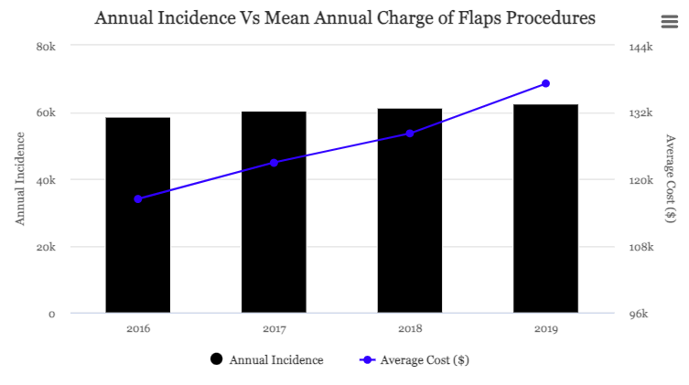
EDA – General

Slide 16
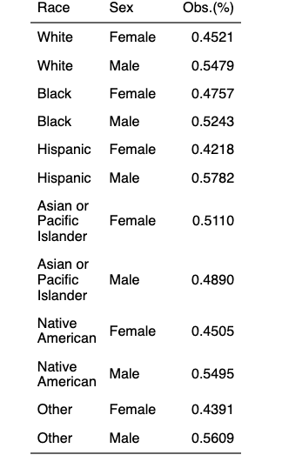
EDA – Patient Demographics

Slide 17
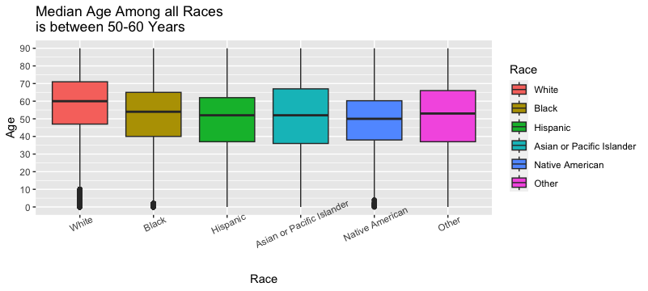
EDA – Patient Demographics

Slide 18
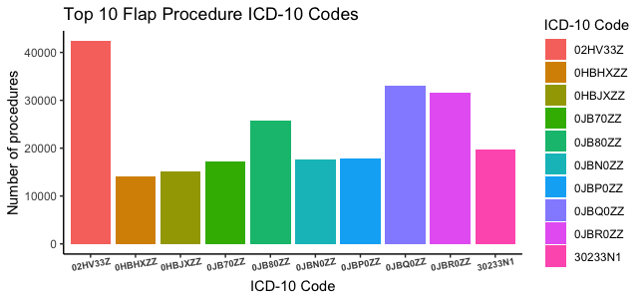
EDA – Procedures

Slide 19
EDA – Procedures
Prefix
02H = Circulatory Insertion
0JB = Tissue & Fascia Excision
302 = Transfusion
0HB = Skin Excision

Slide 20
Statistical Analysis

Slide 21
Generalized Linear Model (GLM)
Class of regression models
Allows for non-normal distributions and/or non-linear relationships
Can be used with categorical and continuous variables
Akaike Information Criterion (AIC) is used to evaluate how well a model fits the data
The lower the AIC, the better the model

Slide 22
GLM – Annual Incidence
Annual Incidence is increasing at rate of 1292 patients
Count is the response variable and year is predictor variable
Distribution is slightly right-skewed
We are 95% confident that the actual slope lies within (1016, 1568)
y = 1292x - 2545754

Slide 23
GLM – Mean Annual Charge
Mean Annual Charge ($) is increasing at a rate of $6733
Average charge is the dependent variable and year is independent
Distribution is left-skewed
We are 95% confident that the actual slope lies within ($5702, $7764)
y = 6733x - 13457644

Slide 24
GLM- Patient Survival What predictor variables are statistically significant?
Predictor Variables | p-value | Statistically Significant?
Year | < 0.0000000000000002 | YES ***
Sex | 0.02084 | Slightly *
Race | 0.00043 | YES ***
Age | < 0.0000000000000002 | YES ***
Length of stay | 0.00088 | YES ***
Number of diagnoses | < 0.0000000000000002 | YES ***
Number of procedures | < 0.0000000000000002 | YES ***
Hospital division | 0.14071 | NO
Household income | 0.000051 | YES ***

Slide 25
GLM- Patient Survival What is the best model for patient survival?
Fit | Model | AIC
1 | Sex | 41804
2 | Race | 40257
3 | Age | 40385
4 | Hospital division | 41808
5 | Household income | 40919

Slide 26
GLM- Patient Survival What is the best model for patient survival?
Fit | Model | AIC
1 | Sex | 41804
2 | Race | 40257
3 | Age | 40385
4 | Hospital division | 41808
5 | Household income | 40919

Slide 27
Final Data Product

Slide 28

Final Data Product National Trends
Incidence of annual flaps procedures could be calculated using the linear regression model
Annual incidence = 1292 * (year) - 2545754
Patient survival is best predicted when considering a patient’s race

Slide 29
Final Data Product National Trends
The increase of flaps procedures could be explained by the population growth in the U.S.
The increase in average cost could be explained by the raising inflation rate.
Aside from Asian/Pacific Islander, slightly over 50% of patients from each racial group is male.
The median age of patients across all races lies between 50 and 60 years, with White patients on the higher end and Native Americans on the lower end.
Tissue & Fascia Excision are the most common procedures.

Slide 30
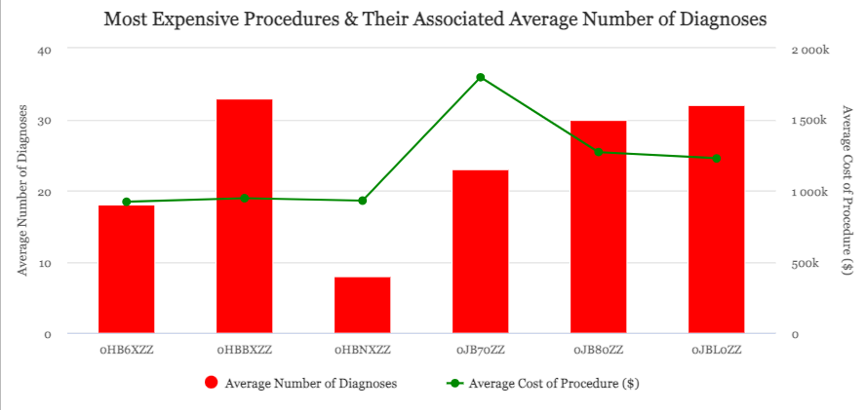
Final Data Product Cost ($) Analysis Top Procedure Cost

Slide 31

Final Data Product Cost ($) Analysis
Mean Annual Charge ($) is increasing at a rate of $6733.
In addition to being the most common, Tissue & Fascia Excision are also among the most expensive procedures.

Slide 32
Overall Experience

Slide 33
Overall Experience
Pro
Con’s
A lot of data to work with
Endless possibilities for analysis
General decent recording of data
Not all years had the same variables
Data is not easily accessible
Inconsistency when reporting NA’s

Slide 34
Recommendations

Slide 35
Recommendations
Update instructional video to include using R
Maintain consistency throughout the years

Slide 36
Acknowledgement

Slide 37
Thank you!
Montgomery College:
Rachel Saidi
Abdirisak Mohamed
Michael Iapalucci
Walter Reed Medical Center:
Mentor: Julio A. Rivera, Ph.D.
Team: Colin J. Harrington, M.D.
Jordan Troph, M.D.
Intern Coordinator: Toby Perkins
Personal Support:
Steven Guerrero
Monica Ochoa
DATA 205 Classmates

Slide 38

The End.
Thank you.

Slide 39
Sources
HCUP
MediVisuals
Dr. Tjoson Tjoa UCI Head & Neck
Mayo Clinic
American Cancer Society
ICD10Data.com
GeeksForGeeks.org

